Slide 1

The National University of Computer and Emerging Sciences
Introduction to Machine Learning
Data Science CS4048
Muhammad Zulqarnain
Department of Computer Science

Slide 2
Lecture slide credit goes to Dr. Akhtar Jamil from the National University of Computer and Emerging Sciences, Islamabad
(Email: akhtar.jamil@nu.edu.pk).
And Dr Amina Asif (my MS supervisor ) from University of Warwick.
(Email:amina.asif@warwick.ac.uk)

Slide 3
Goals
What is learning?
What is machine learning?
Types of machine learning
Classification vs Regression
Clustering vs Density Estimation

Slide 4
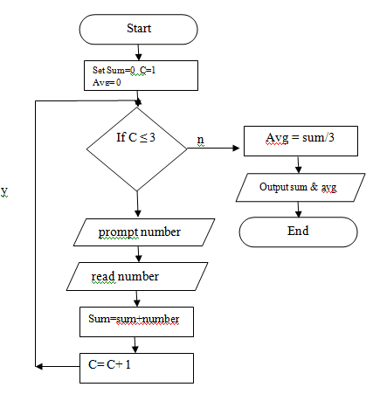
What is Learning?
How can we solve a specific problem?
We write a program with a set of rules that are useful to solve the problem.
Example: Find average of
three numbers

Slide 5
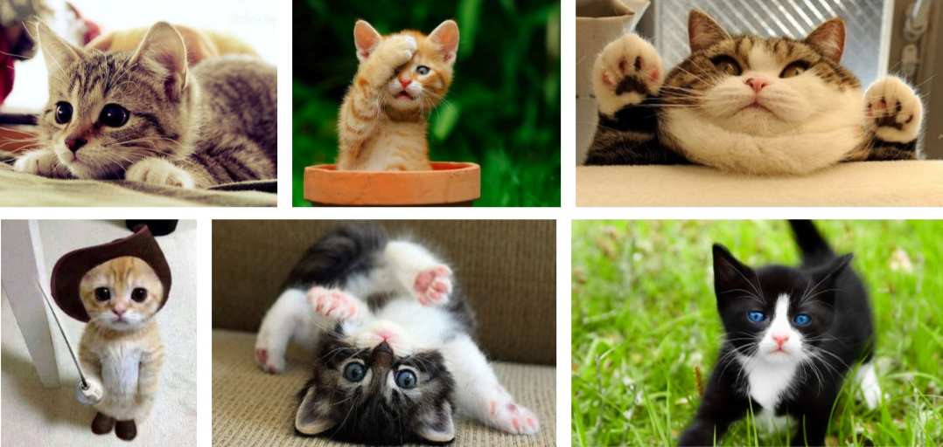
What is Learning?
In many situations it is very difficult to specify those rules to solve a problem.
For example, given a picture determine whether there is a cat in the image

Slide 6
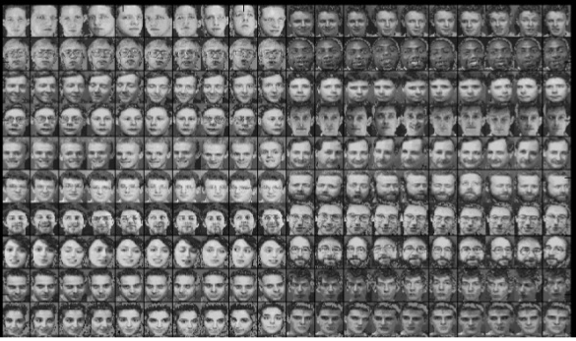
What is Learning?
Find face of a specific person?

Slide 7
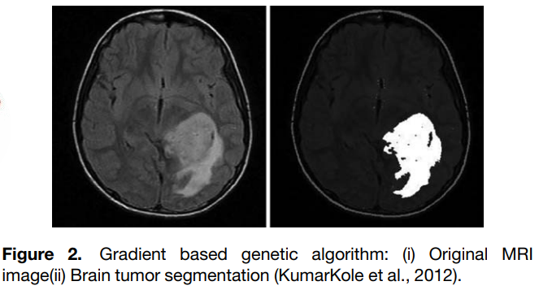
What is Learning?
Benign vs Malignant tumor

Slide 8

What is Learning?
Any learning systems are not directly programmed using conditions to solve a problem
Instead it should learn from examples (data)
From trial-and-error experience trying to solve the problem

Slide 9
What is Machine Learning?
Machine Learning is the science (and art) of programming computers so they can learn from data.
[Machine Learning is the] field of study that gives computers the ability to learn without being explicitly programmed.
Arthur Samuel, 1959
Notes:
instead of being manually programmed for every task, computers can learn patterns from data and make decisions or predictions based on experience

Slide 10
What is Machine Learning?
Machine learning can be defined as computational methods using experience to improve performance or to make accurate predictions.
Experience refers to the past information.
Mohri et al

Slide 11

What is Machine Learning?
Definition: “A computer program is said to learn from experience E with respect to some class of tasks T and performance measure P, if its performance at tasks in T, as measured by P, improves with experience E”
Tom M. Mitchel

Slide 12
Learning to Predict House Prices
Experience (E): The program analyzes past data of houses, including size, location, and price.
Tasks (T): Predicting the price of a house based on given features.
Performance Measure (P): The accuracy of price predictions compared to actual house prices.

Slide 13
Spam Tagging Problem
For Spam classification:
The task T is to flag spam for new emails
The experience E is the training data,
The performance measure P needs to be defined;
Percentage of correctly classified emails (accuracy)

Slide 14
Spam Tagging Problem
Your spam filter is a Machine Learning program
Binary Classification Problem: spam emails or nonspam
To train a machine learning model, examples of emails that are spam and nonspam should be presented to the model
Usually flagged by users
The examples that the model uses to learn are called the training set.
Training instance (or sample).

Slide 15

A checkers learning problem
Task T: playing checkers
Performance measure P: percent of games won against opponents
Training experience E: playing practice games against itself

Slide 16
Learning to Recognize Handwritten Digits
Experience (E): The program is trained on thousands of images of handwritten numbers.
Tasks (T): Identifying digits (0-9) from handwritten text.
Performance Measure (P): The accuracy of correctly recognizing digits.
Learning: As the model sees more handwritten digits, it improves its ability to recognize numbers accurately, even from different handwriting styles.

Slide 17
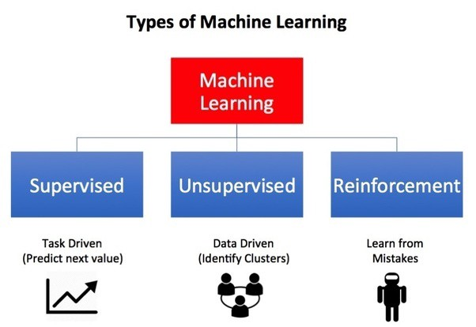
Types of Machine Learning…

Slide 18
Supervised learning
For supervised learning, we provide both data and labels for training the algorithm.
The algorithms learns from the data and labels
After training, we can pass test samples to check if the algorithm learned the data or not
Most popular in ML community

Slide 19
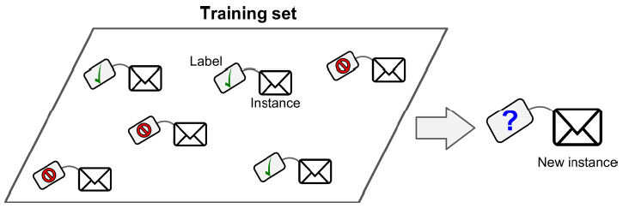
Supervised learning: Example

Slide 20
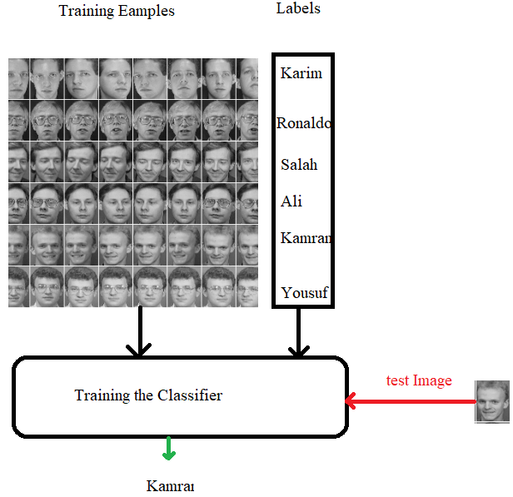
Supervised learning: Example

Slide 21
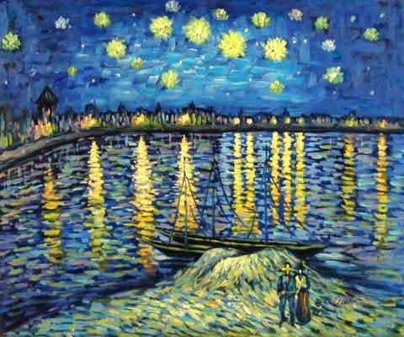
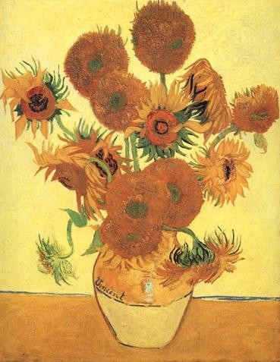
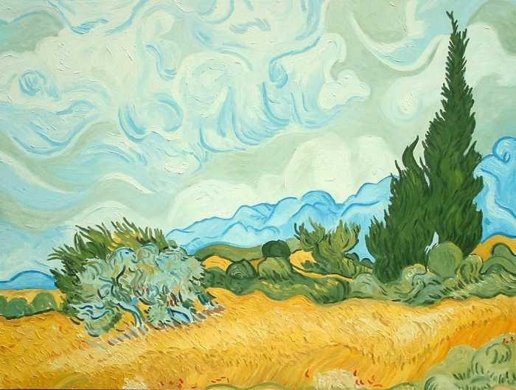
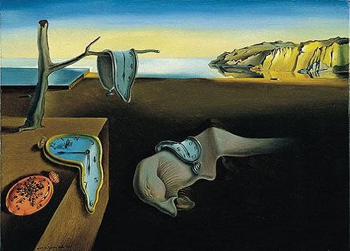
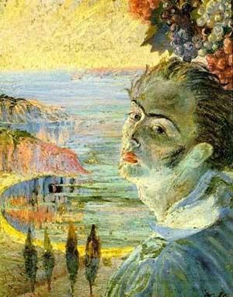
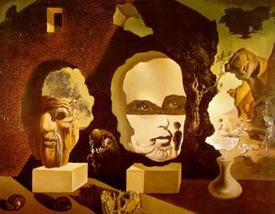
Paintings by two different painters

Slide 22
Who’s painting is this?

Slide 23
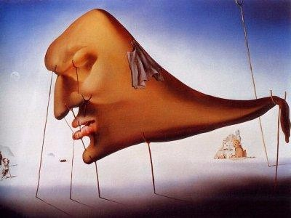
And this?
learning from data for generalization to unseen cases

Slide 24
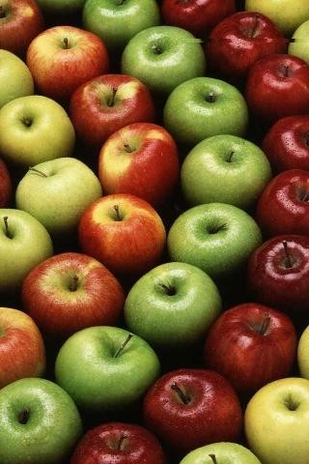
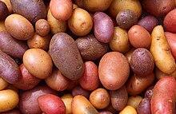
How many categories (clusters) are there?

Slide 25
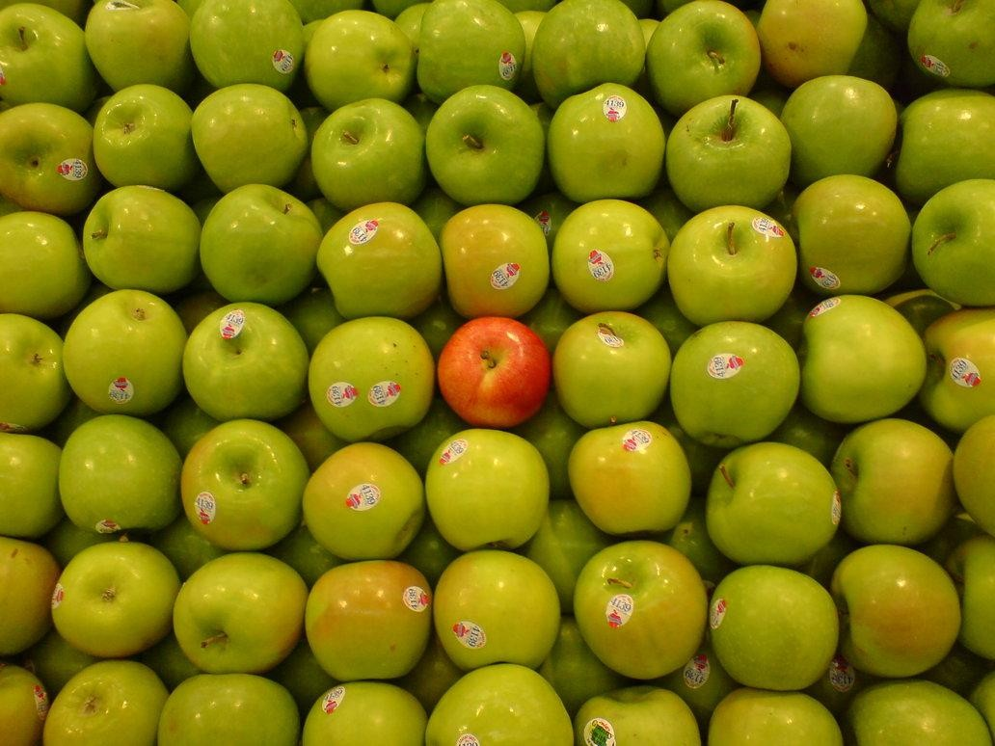
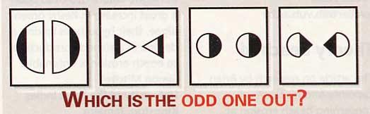
Find the odd one out!

Slide 26
Predict the next element
1,1,2,3,5,8,13,
21

Slide 27
Question?
Consider the vectors
– X₁=[1 2 1 4]^{T}
– X₂=[2 4 2 4]^{T}
– X₃=[0 0 0 4]^{T}
– X₄=[3 6 3 4]^{T}
– X₅=[4 8 4 4]^{T}
To store each vector, how many dimensions (or variables) do we need?

Slide 28
𝑥₂
Positive Example Negative Example
𝑥₁

Slide 29
Classification Approaches: Nearest Neighbor and kNN
𝐷 𝒙 , 𝒙 =
_{𝑥}(1) _{− 𝑥}(1)
2
+
_{𝑥}(2) _{− 𝑥}(2)
2
𝒂 𝒃
𝑎
𝑏
𝑎
𝑏
_{𝑥}(2)
?
Positive Example Negative Example
_{𝑥}(1)
Python Warm-up Lab Exercise
https://github.com/foxtrotmike/CS909/blob/master/DM_1_kNN.ipynb

Slide 30
We want to make a machine that will be proud of us.
- Danny Hillis

Slide 31
Supervised Learning

Slide 32
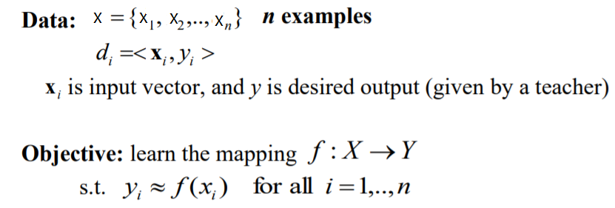
Supervised learning

Slide 33
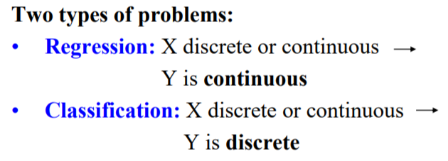
Supervised learning

Slide 34
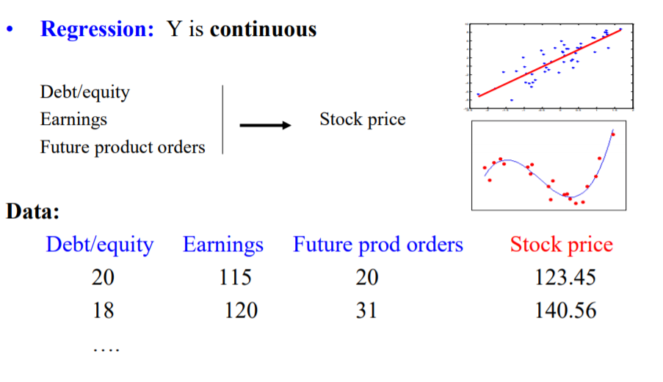
Supervised learning

Slide 35
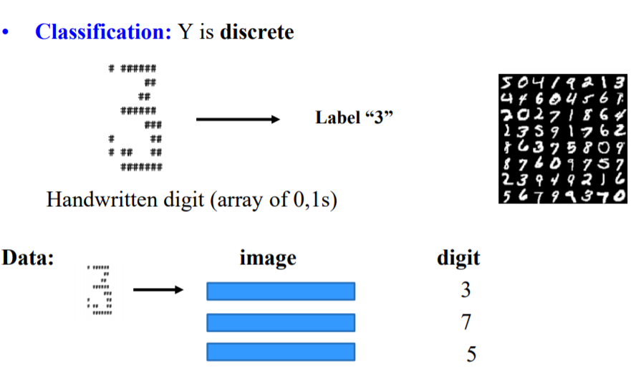
Supervised learning

Slide 36
Supervised learning
Can regression algorithms be used for classification and vice versa?
Yes, some algorithms can be used.
Logistic Regression is commonly used for classification
Predicts probability belonging to a class

Slide 37
Supervised learning
Some widely used supervised ML algorithms:
Linear Regression
Logistic Regression
Support Vector Machines (SVMs)
Decision Trees and Random Forests
Neural networks
k-Nearest Neighbors

Slide 38
Unsupervised learning
For unsupervised learning, we provide data but NOT labels for training the algorithm
The system tries to learn without a teacher.
Learns relations among data by itself
Then put the data into different groups/clusters

Slide 39
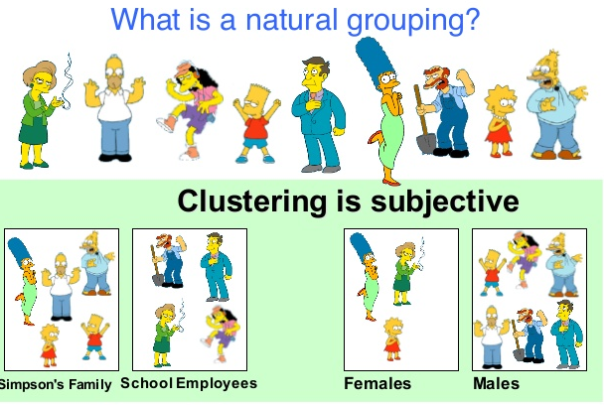
Unsupervised Learning

Slide 40
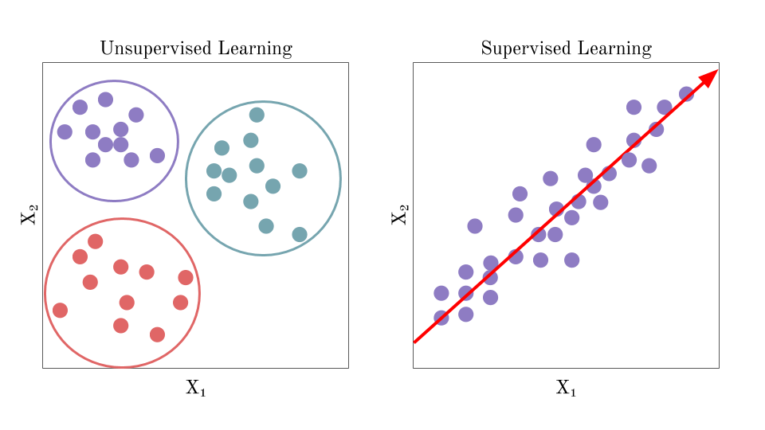
Unsupervised Learning
Notes:
Based in similarities and differences

Slide 41
Unsupervised Learning
Some widely used unsupervised learning algorithms:
K-Means
Principal Component Analysis (PCA)
Apriori
Hierarchical Cluster Analysis (HCA)
One-class SVM

Slide 42
Usage of Unsupervised Learning
Data visualization
Dimensionality reduction
Clustering
Anomaly detection

Slide 43
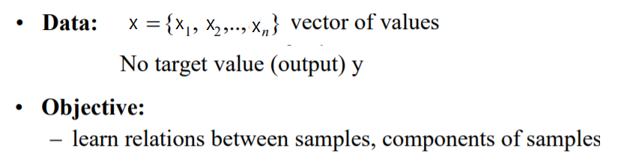
Unsupervised Learning

Slide 44
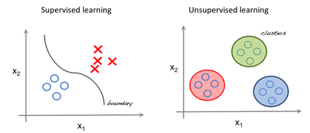
Supervised vs Unsupervised Learning
Labels: y

Slide 45
Reinforcement learning
The learning system, called an agent, can observe the environment, select and perform actions:
Get positive rewards for good actions
Get negative rewards for wrong action
Reinforcement learning refers to goal-oriented algorithms, which learn how to attain a complex objective (goal) or maximize

Slide 46
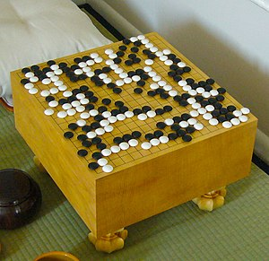
Reinforcement learning
It must then learn by itself what is the best strategy
Policy: best strategy
A policy defines what action the agent should choose when it is in a given situation.
Example:
Playing games, Robotics
Robots learn how to walk.
DeepMind’s AlphaGo

Slide 47
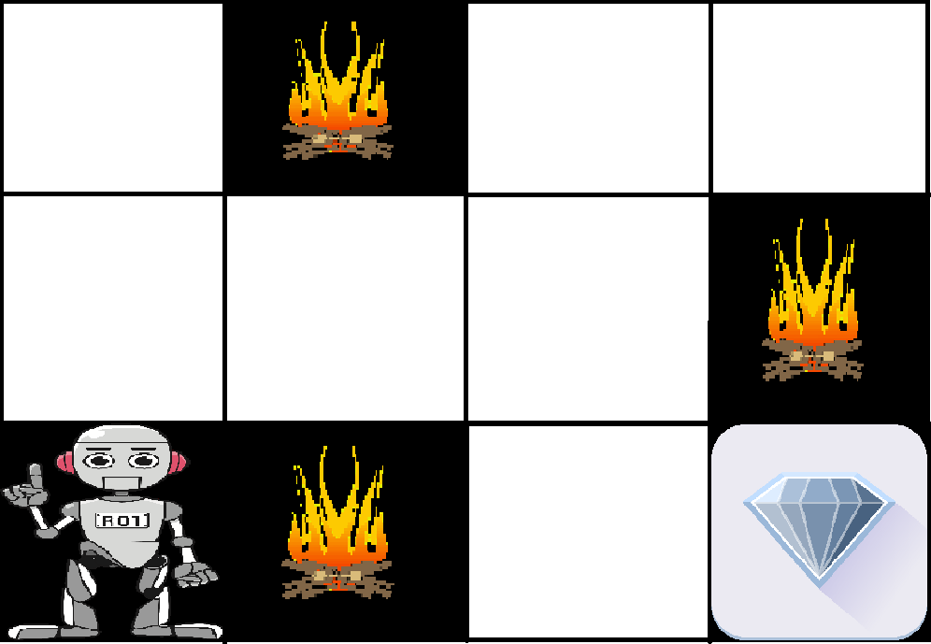
Reinforcement learning

Slide 48
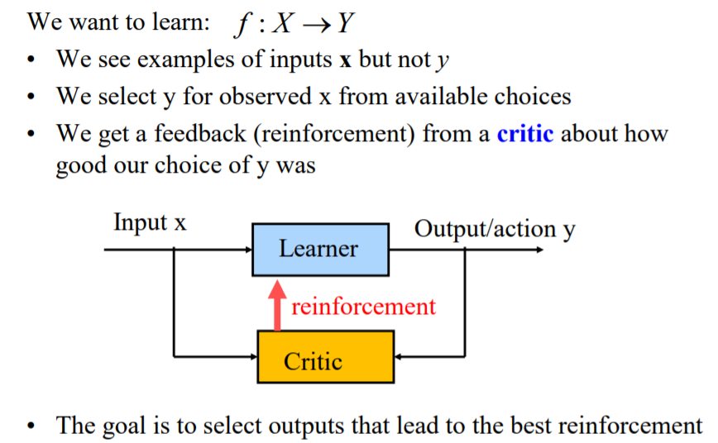
Reinforcement learning

Slide 49
Reference
Read 1st Chapter of Hands-on Machine Learning with Scikit-Learn, Keras, and TensorFlow- (2019)
https://towardsdatascience.com/workflow-of-a-machine-learning-project-ec1dba419b94
https://cloud.google.com/ai-platform/docs/ml-solutions-overview

Slide 50
Thank You ☺

